Slide 1
Inspirational Dynamic Packaging with Generative AI
Powered by Camino Network

Slide 2
Agenda
The Problem, The Vision and The Solution
The Traveler’s Journey (Demo)
Real-World Applications
Market Opportunity & Revenue Model
The Future
Feedback and Q & A

Slide 3
The Problem
Static and Unengaging: Packaging often fails to connect emotionally with consumers, resulting in a missed opportunity for brand differentiation.
Lack of Personalization: Today’s consumers crave personalized, meaningful experiences, but packaging often feels generic.
Inefficient and Wasteful: Overproduction of standard packaging leads to excess inventory, waste, and higher costs.
Missed Consumer Interaction: Packaging is often overlooked as a potential touchpoint for ongoing engagement.
Notes:
Traditional Packaging is Outdated

Slide 4
The Vision
Transforms packaging from a passive container into an inspiring, personalized experience that evolves with the customer. By using Generative AI and the Camino Network, we create dynamic, context-aware packaging that not only protects your product but also enhances your brand’s emotional connection with the consumer.

Slide 5
The Solution
Personalization & Inspiration: AI-driven design allows for mass personalization, reaching each consumer with something unique, without the complexity or costs of traditional customization.
Interactive Experience: Packaging becomes part of the consumer journey, encouraging interaction, social sharing and loyalty.
Reduced Waste & Costs: With on-demand production, brands can minimize overproduction significantly reducing waste.

Slide 6
Powered by Camino Network
Scalable & Secure: Built to scale with your brand, the Camino Network connects seamlessly to your existing systems while ensuring data privacy and security.
Real-Time Insights: The network allows for constant data exchange and updates, providing up-to-the-minute intelligence on consumer behaviors, trends, and even environmental changes.
A new Package Service within the Camino Messenger portfolio, featuring advanced algorithms for creating custom packages.
Introducing a new bot sub-type, Combinator, to enhances functionality by combining multiple actions or processes.
Easy to integrate with new content and suppliers to enrich the customer experience.

Slide 7
How It Works – The Traveler’s Journey
Step 1: Initial Interaction
The traveler starts a conversation with generative AI bot.
They provide preferences such as destination, near airports, travel dates, and any special requests.
Step 2: Package Creation
Camino Messenger processes the data in real-time.
Connects with suppliers to create a highly personalized travel package, including flights, hotels, activities, and local experiences.
The system offers multiple package options based on the traveler’s preferences.
Step 3: Booking and Confirmation
Once the traveler is satisfied with their customized package, they can complete the booking process directly through Camino Messenger. The package is confirmed, and all necessary information (NFTs) is delivered instantly.

Slide 8
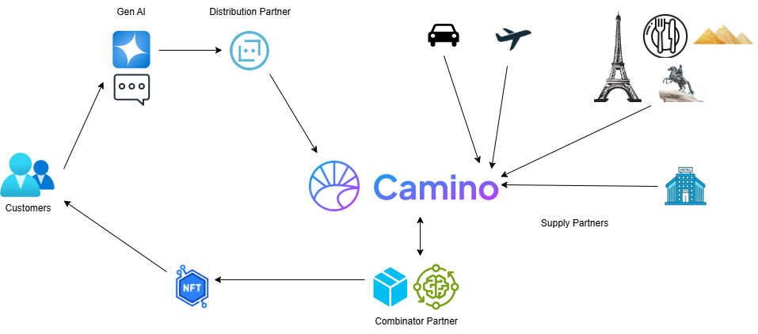
How It Works – The Traveler’s Journey

Slide 9
Use Case (Demo): Personalized Italian Vacation
Imagine a customer logs into a travel website and inputs their interests: they want to go to Spain, explore history, enjoy food, and have a luxurious experience.
Step 1: The AI analyzes the traveler’s requests, interests (history, fine dining, and relaxation) and preferences (luxury hotel, beach resort, guided tours).
Step 2: Packages service generates an inspirational travel itinerary that includes:
Flights from the customer’s nearest airport
Luxury hotels in Barcelona with historical significance
Custom-guided tours of historical landmarks, such as the la Sagrada Família and Ciutadella Park
Tapas experience with gourmet wines
A day of leisure on the nearest coast
Step 3: The customer can adjust their itinerary in real time, adding or removing activities, changing dates, or modifying their hotel preferences.
Step 4: The traveler books the package through Camino Messenger and receiving a confirmation in his wallet.

Slide 10
Real-World Applications
Travel Agencies & OTAs: Travel agencies and online platforms can integrate Camino Messenger to provide real-time, personalized travel experiences. This allows for better engagement, faster response times, and higher conversion rates.
Tour Operators: Tour operators can use the Camino Messenger to dynamically adjust packages based on demand, availability, and customer behavior.
Local Experience Discovery & Booking: Recommend and book local experiences that align with the traveler’s preferences and itinerary, such as local tours, cooking classes, or tickets to events, concerts or festivals.

Slide 11
Market Opportunity
Growth of E-Commerce and Direct-to-Consumer Models
Rising Consumer Demand for Personalization
Brand Differentiation and Engagement
Technological Advancements with Blockchain, AI & Data Analytics

Slide 12
Revenue Model
Subscription-Based Licensing: Brands can subscribe to Camino Messenger to access the Packages service.
Print-on-Demand Fees: Brands pay per unit of dynamic packaging produced on demand.
Customization Services: Premium services for deeper customization, including high-end design consultations and extended customer support.
Data Analytics: Monetizing insights derived from consumer behavior data, providing brands with actionable intelligence for marketing and product development.

Slide 13
The Future Development
New Packages service and Protobuf message definition in Camino Messenger API
Advanced Personalization - customer preferences, travel trends, weather conditions, local events
Integration with different product suppliers
Collaborations with local Experts & Activities
Loyalty & Reward program
Predictive Packaging Trends
Augmented Reality (AR) and Interactive Packaging
Voice-enabled travel assistance

Slide 14
Conclusion
Camino Network and Camino Messenger combine the power of generative AI and real-time communication to deliver dynamic, personalized travel packages.
This integration offers travelers more flexibility, inspiration, and real-time assistance, while providing travel agencies with powerful tools to create unique, data-driven experiences.
By embracing Camino’s ecosystem, we can revolutionize the way we package, sell, and experience travel—ushering in a new era of personalized, responsive, and data-driven travel.

Slide 15

Feedback
Innovation and Originality
Team Collaboration and Presentation
Market Fit and Business Potential
Hands-on experience with Camino and blockchain

Slide 16
Q & A

Slide 17
THANK YOU
My Friend team
Let’s create unforgettable journeys together
powered by
Camino’s cutting-edge technology!

